Slide 1

FY Membership Renewals

Slide 2

AGENDA
Problem Overview
Solution Approach
Data & KPIs
EDA
Recommendations

Slide 3
AGENDA
Problem Overview
Solution Approach
Data & KPIs
EDA
Recommendations

Slide 4
Problem Overview
Sam’s Club has membership based model. Members must renew their membership to continue to shop at Sam’s Club. If they do not renew, they are considered as “attrited”
Goal - Determine what drives a first year member to renew
What does an "ideal" FY member look like?
1
What can we do to retain more FY members and prevent churn?
2

Slide 5
AGENDA
Problem Overview
Solution Approach
Data & KPIs
EDA
Recommendations

Slide 6
Four-Step Approach
Problem Understanding
Data Processing
Data Analysis & Modeling
Insights & Recommendations

Slide 7
AGENDA
Problem Overview
Solution Approach
Data & KPIs
EDA
Recommendations

Slide 8



Data and KPIs
Membership Type
Age
Marital Status
Ethnicity
Income
Miles to Club
Member
Derived Metrics (KPIs)
Basket Size
Inter Purchase Interval
Sales per Visit
Visit Frequency
Items per Visit
Time of Day
Time of Purchase
Quantity
Sales
Store Geography
Product Description
Tender type & Amount
Point of Sale and Tender
Category IDs
Product Name
Cost price
Product Description
Product Attribute

Slide 9
AGENDA
Problem Overview
Solution Approach
Data & KPIs
EDA
Recommendations

Slide 10
Setting the ground..
80% of our customers are savings members
19% of our customers are on auto-renewal
~77% of the total sales came from renewed customers
~68% of the sales transactions were done using cards
Top 5 clubs accounted for ~11% of Sam’s sales
77% of customers who visit Sam’s club on their Date to Renew tend to renew

Slide 11
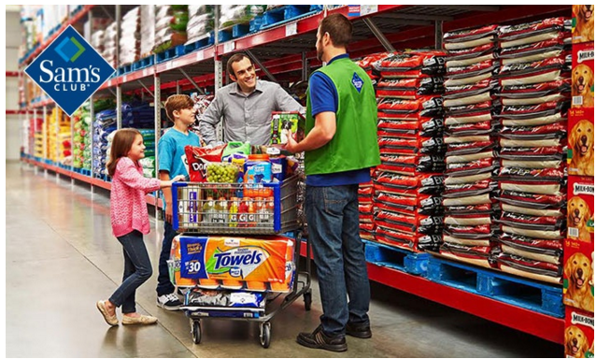



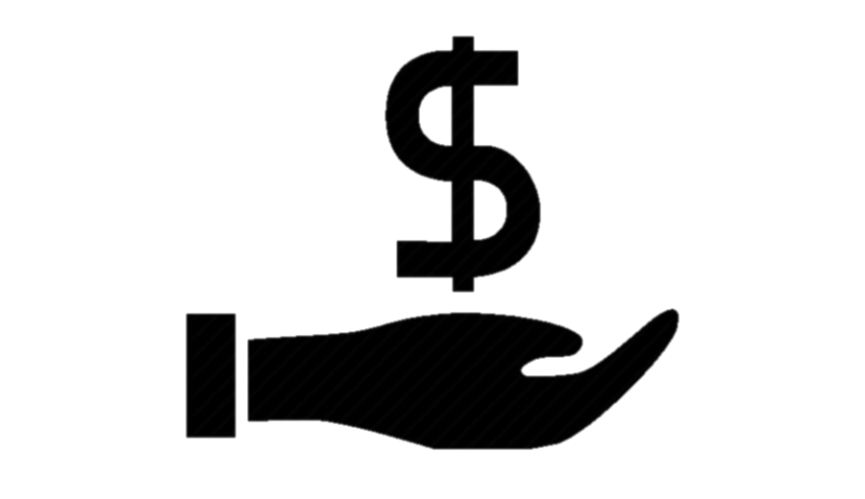
What’s an Average first year member Like?
Lives 5.92 miles away
49 years old
Married with 0-2 children
Earn $50K - $74K

Slide 12
Feature Selection on Member Attributes

Slide 13
Feature Selection on Member Attributes

Slide 14
How far away do our customers live?
Renewed
More than 50% of First Year Members live within 6 miles
Churned
Median 5.87 miles

Slide 15
How old are our customers?
Renewed
75% of the members are 30-70 years old
75%
Notes:
Household owners
Bigger family size
More disposable income

Slide 16
Base vs. Plus Members

Slide 17
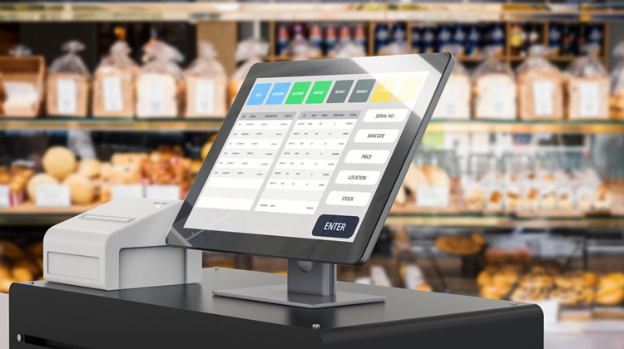
Customer Transactions
Metrics we looked at..
Visit
1
Visits, Visit Freq, Inter Purchase Freq
Sale
2
Sales, Sales per Visit, Sales by Category
Time
3
Time, Day, Week and Month trends
Others
4
Tender type, club, region etc.

Slide 18
Customer Transactions
Renewed vs. Churned
Visit
1
Visits, Visit Freq, Inter Purchase Freq
Sale
Sale
2
Sales, Sales per Visit, Sales by Category
Time
3
Time, Day, Week and Month trends
Others
4
Tender type, club, region etc.

Slide 19
How does visit frequency vary?
Renewed customers visited 2x more* than a churned customer

Slide 20
How does Inter Purchase Interval vary?
Renewed customers visited 2x more* than a churned customer
Renewed customers visited at least twice a month
~20% of renewed customers visited Sam’s club every 10 days
Inter Purchase Interval*
S | S | M | T | W | T | F
S | S | M | T | W | T | F
< 3 weeks
> 4 weeks
Renewed
Churned

Slide 21
How often do customers visit?
Renewed
Renewed customers visited 9 of 12 months
0
Months
12
Churned customers visited only 4 of 12 months
Churned
25% of renewed customers visited Sam's club every month
Month one of the membership is the most active month for most of Sam’s customers

Slide 22
Do renewed customers shop more?
Renewed customers accounted for 77% of total sales; 15% of it from the 1st month alone
Renewed
Churned
Month

Slide 23
Do renewed customers shop more?
Renewed Business customers purchased 3x more than churned
Renewed Savings customers purchased 2X more than churned

Slide 24
When do our customers shop?
Sales from renewed members stayed more or less steady between months 3 and 11
Renewed

Slide 25
When do our customers shop?
Sales from churned members showed a major decline starting month 3
Churned

Slide 26

Quick Recap
19
Annual Visits
8
< 3 weeks
Interpurchase frequency
> 4 weeks
9 of 12
Months Visited
3 of 12
~$2800
Sales
~$1100
Cards
Tender Type
Cash
FY Renewed
FY Churned

Slide 27
AGENDA
Problem Overview
Solution Approach
Data & KPIs
EDA
Recommendations

Slide 28





Ideal FY renewing member
Profile
Age: 35+
Marital Status: Married
Family Size: 2 to 3
Interaction
Proximity: <6 miles
Visits: 2 per month
Intervisit: <20 days
Transaction
Sales: $250 per month
Basket Size: 10-12
Tender Type - Cards

Slide 29



Recommendations
Proactively Target
Early Reminders
Evangelize Plus
Observe sales dip post 3 or 4 months from membership sign up date
Track irregularities in visits/intervisits across months
Send multiple reminders during the last quarter of membership
Use different channels to send reminders
Offer a trial period of plus membership to new customers during sign up
Increase investments on converting base to plus membership

Slide 30
THANK YOU
Savings Made Simple

